Slide 1

IT Capstone Project
Team Members:
Antonio George
Bianca Guimaraes Barros Leal Santos
Jacob Castro
Muhammad Fotih Abdullaev
Milestone #3

Slide 2
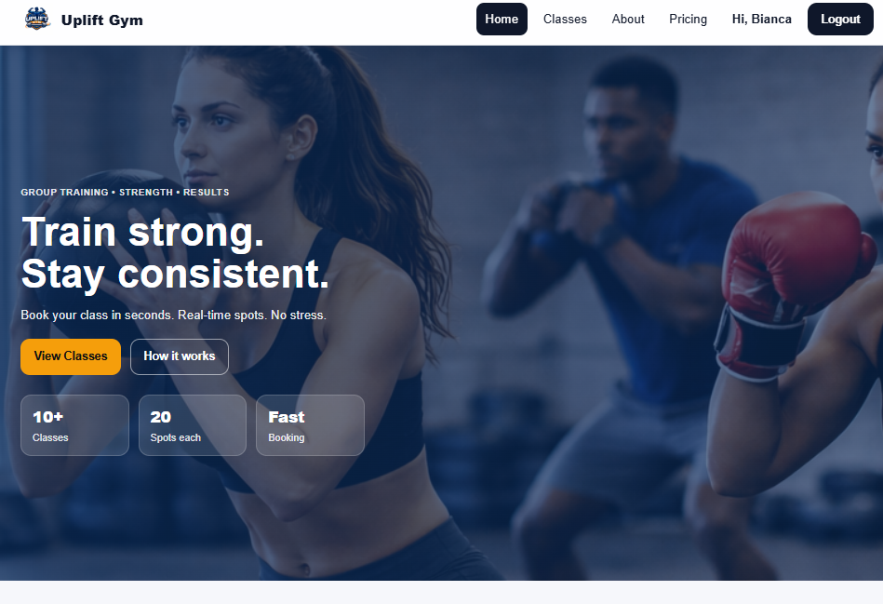
Prototype Overview
Functional prototype
Frontend ↔ Backend connected
Booking and payment working
Full user flow
https://upliftgym.de/

Slide 3
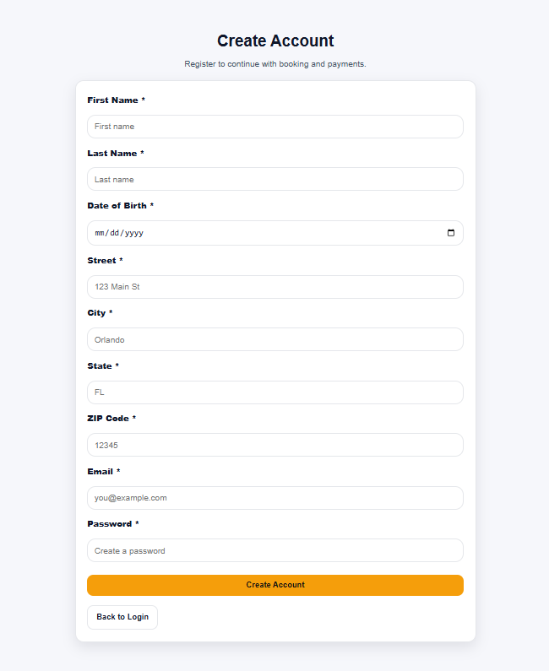
Frontend
All pages created
Booking flow works
Login and signup implemented
Navbar changes (login / user / logout)
Works on phone and computer

Slide 4
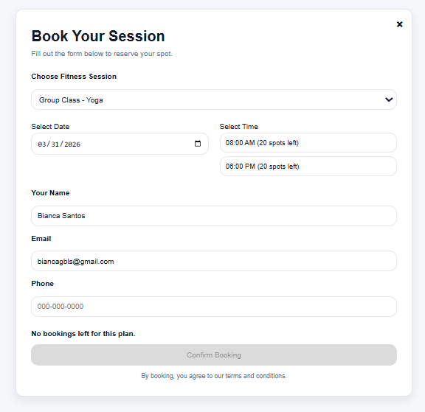
Booking System
Single class – Payment required
Starter – 2 classes per week
Plus – 4 classes per week
Unlimited – No limit
System tracks bookings
Shows remaining classes

Slide 5
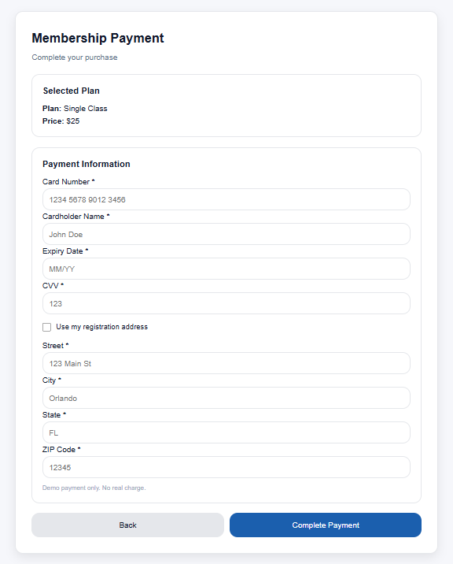
Payment
Payment system implemented
Form validation for all fields
Payment for single class or membership
Membership allows booking multiple classes

Slide 6
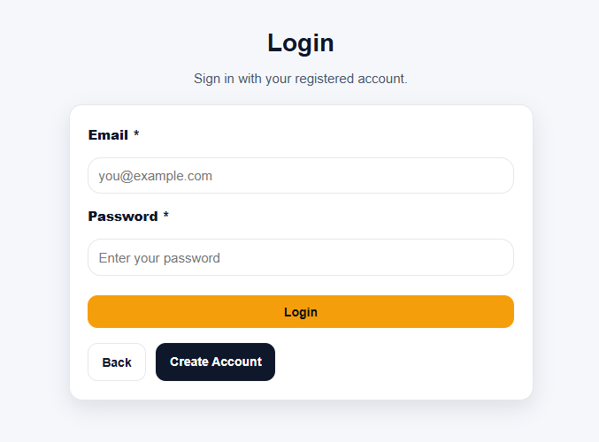
User System
Login and signup work
User session maintained
Membership saved in account
Data stays after logout

Slide 7
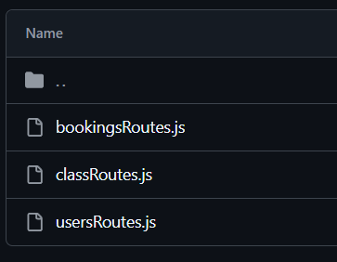
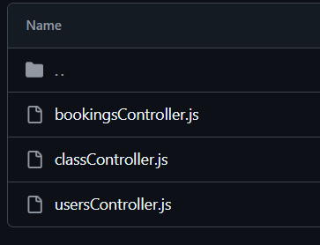
Backend
MySQL database connected
Routes and controllers created
Booking and user queries added
Moving from test data to real data

Slide 8
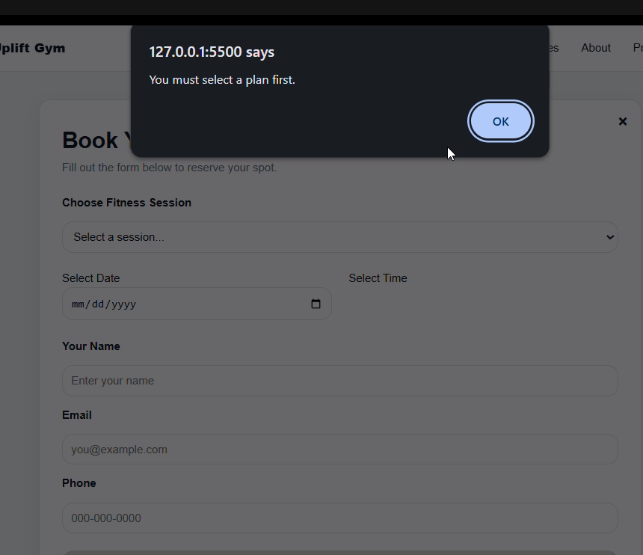
Testing
Tested booking limits
Tested payment validation
Tested login/logout
Tested full booking flow
Tested UI

Slide 9
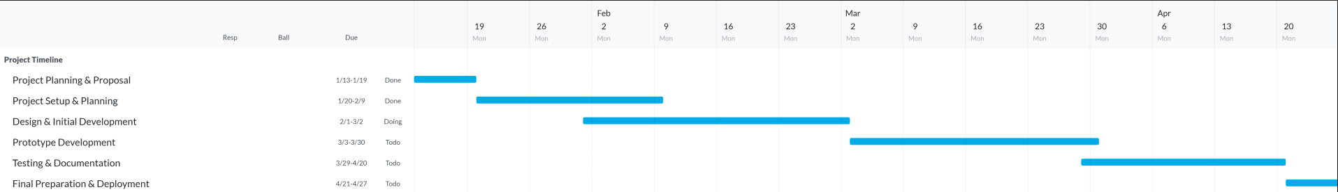
Project Timeline

Slide 10
Thank you!

